Slide 1
GEARS

Slide 2
Gears
Gears are toothed, cylindrical wheels used for transmitting motion and power from one rotating shaft to another.
Most gear drives cause a change in the speed of the output gear relative to the input gear.
Some of the most common types of gears are spur gears, helical gears, bevel gears, and worm/wormgear sets.

Slide 3
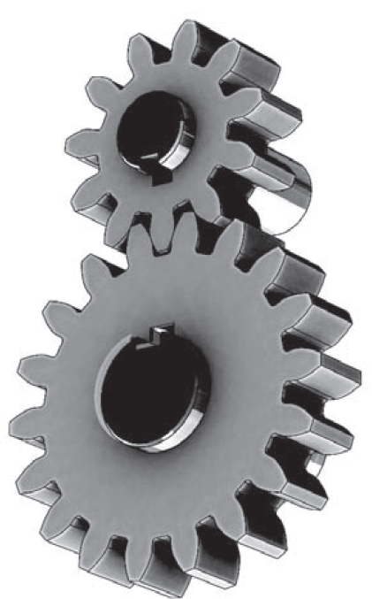
Speed Reduction
If the smaller top gear, called a pinion, is driving the larger lower gear, simply called the gear, the larger gear will rotate more slowly.

Slide 4
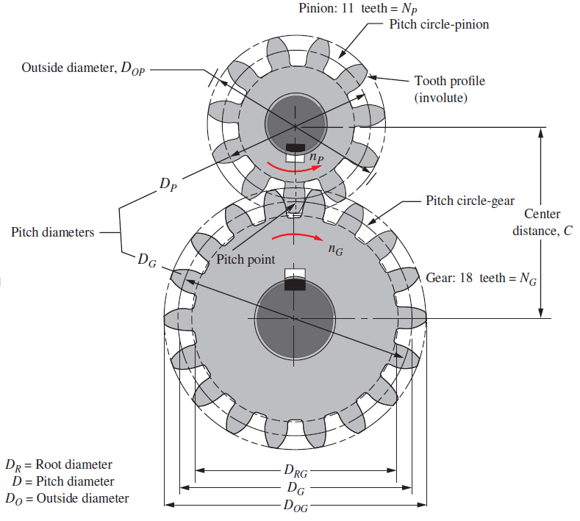

Slide 5
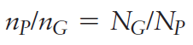
Speed Reduction
The amount of speed reduction is dependent on the ratio of the number of teeth in the pinion to the number of teeth in the gear according to this relationship:

Slide 6
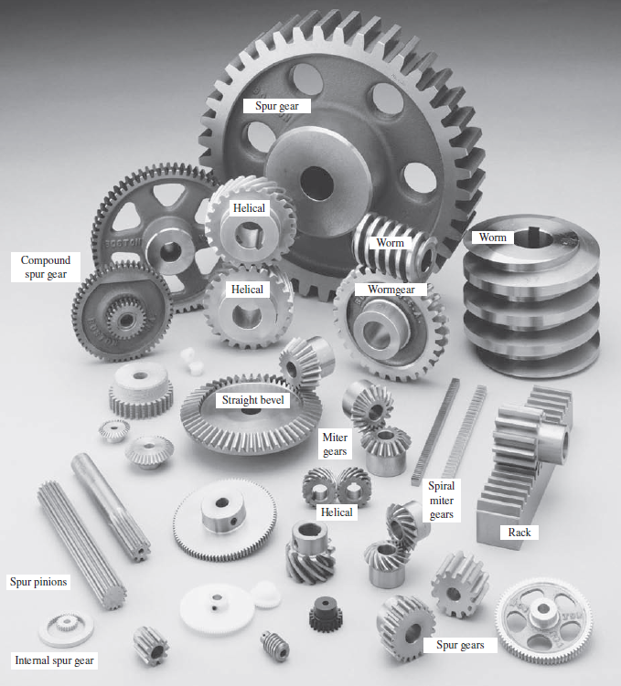
Kinds of Gears
The major types of the gears that we will discuss are:
spur gears, helical gears, bevel gears, and worm/worm-gear sets.

Slide 7
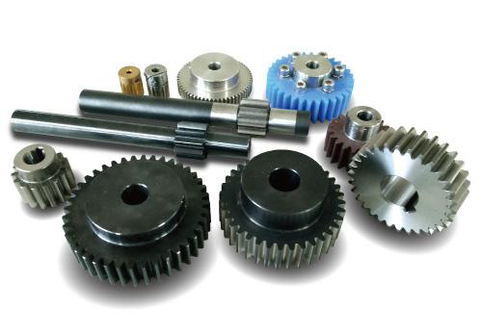
Spur Gears
Spur gears have teeth that are straight and arranged parallel to the axis of the shaft that carries the gear.
The curved shape of the faces of the spur gear teeth have a special geometry called an involute curve.
Note: The shafts
carrying the gears are parallel.

Slide 8
Helical Gears
The teeth of helical gears are arranged so that they lie at an angle with respect to the axis of the shaft.
The angle, called the helix angle, can be virtually any angle.
Typical helix angles range from approximately 10° to 30°, but angles up to 45° are practical.
The helical teeth operate more smoothly than equivalent spur gear teeth, and stresses are lower.

Slide 9
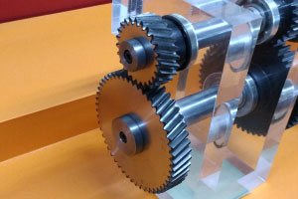

Slide 10
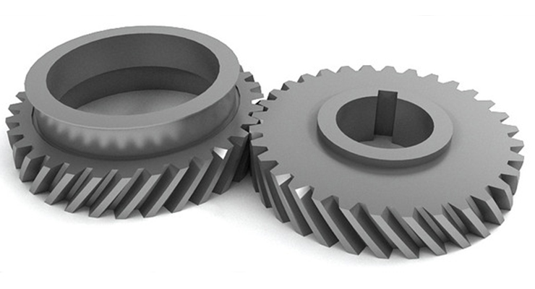
One disadvantage of helical gears is that an axial force, called a thrust force, is generated in addition to the driving force that acts tangent to the basic cylinder on which the teeth are arranged.

Slide 11
Bevel Gears
Bevel gears have teeth that are arranged as elements on the surface of a cone.
The teeth of straight bevel gears appear to be similar to spur gear teeth, but they are tapered, being wider at the outside and narrower at the top of the cone.
Bevel gears typically operate on shafts that are 90° to each other.
Specially designed bevel gears can operate on shafts that are at some angle other than 90°.

Slide 12
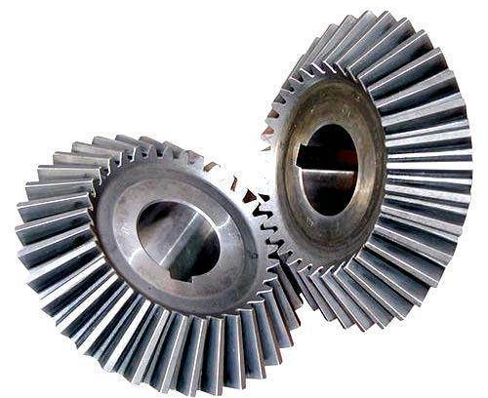
Straight bevel gears

Slide 13
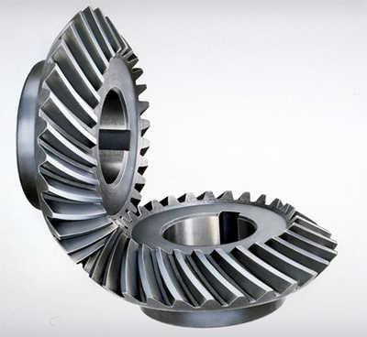
When bevel gears are made with teeth that form a helix angle similar to that in helical gears, they are called spiral bevel gears.
When both bevel gears in a pair have the same number of teeth, they are called miter gears and are used only to change the axes of the shafts to 90°.

Slide 14
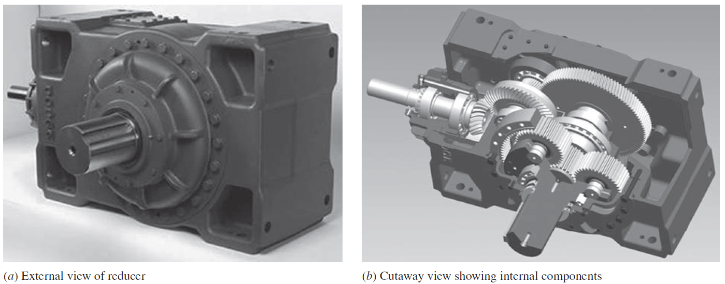
Gear Reducers

Slide 15
Gear Reducer Example
The input shaft at the left end carries the spiral bevel pinion for the right angle first stage of reduction.
The helical pinion behind the output gear of the bevel gear pair drives the large helical output gear of the second stage of reduction.
The output shaft from the helical gear pair carries the spur-type sun gear of a planetary gear train whose output shaft drives the final output shaft projecting from the front of the reducer.

Slide 16
Gear Reducers

Slide 17
Rack and Pinion
A rack is a straight gear that moves linearly instead of rotating.
When a circular gear is mated with a rack, the combination is called a rack and pinion drive.
A worm and its mating wormgear operate on shafts that are at 90° to each other.
The worm is the driver, and the wormgear is the driven gear.
One disadvantage of the worm/wormgear drive is that it has a somewhat lower mechanical efficiency than most other kinds of gears because there is extensive rubbing contact between the surfaces of the worm threads and the sides of the wormgear teeth.

Slide 18
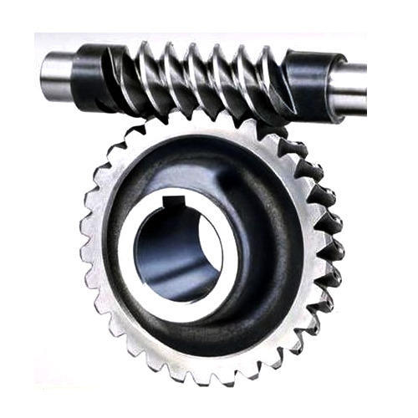
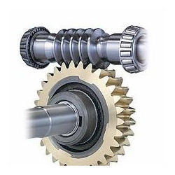
Worm Gears

Slide 19
Discussion
Where Have You Observed Gears? Think of examples where you have seen gears in actual equipment.
Describe the operation of the equipment, particularly the power transmission system.
Try to answer the following questions:
What was the source of the power?
How were the gears arranged together, and how were they attached to the driving source and the driven machine?
Was there a speed change?
Were there more than two gears in the drive system?
What materials were the gears made from?
How were the gears attached to the shafts that supported them?
How were the shafts themselves supported?
Was the gear transmission system enclosed in a housing? If so, describe it.

Slide 20
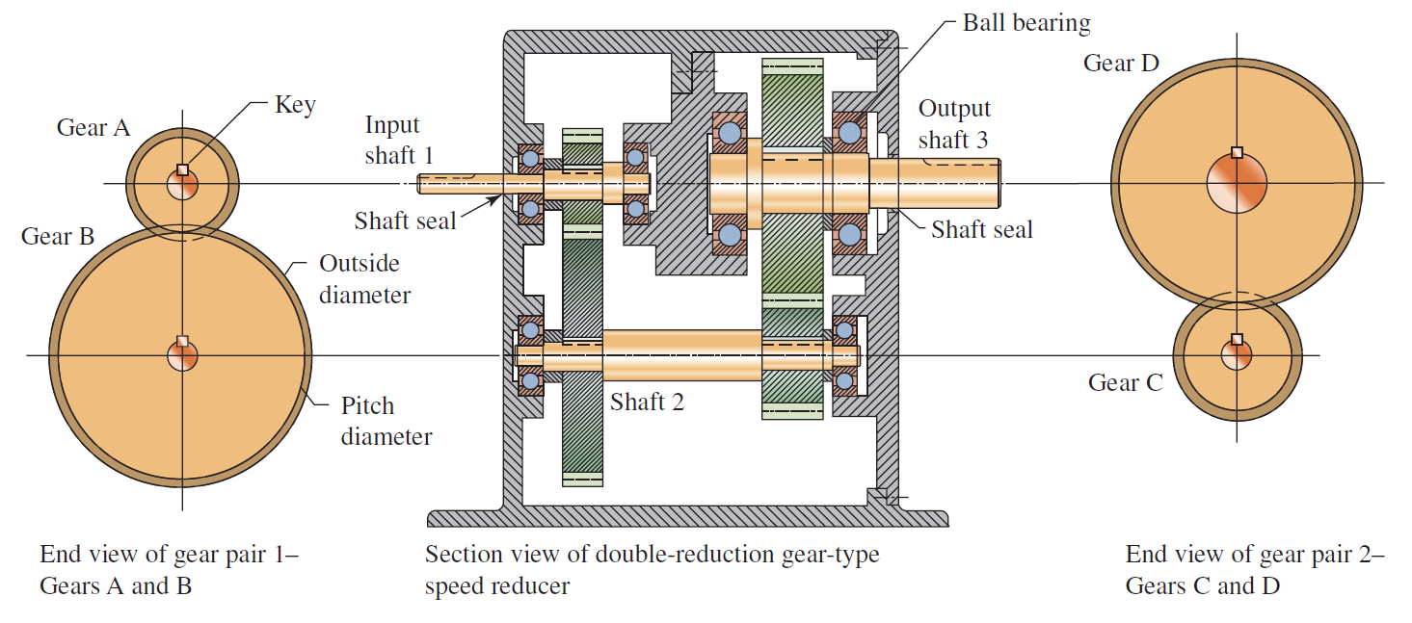
You are the Designer
Assume that you are responsible for the design of a speed reducer that will take the power from the shaft of an electric motor rotating at 1750 rpm and deliver it to a machine that is to operate at approximately 292 rpm. You have decided to use gears to transmit the power, and you are proposing a double-reduction speed reducer

Slide 21
Let’s say that you have chosen to use spur gears in your design. The following list gives some of the important parameters for each gear:
The number of teeth.
The form of the teeth.
The size of the teeth as indicated by the pitch.
The width of the face of the teeth.
The style and dimensions of the gear blank into which the gear teeth are to be machined.
The design of the hub for the gear that facilitates its mounting to the shaft.
The degree of precision of the gear teeth and the corresponding method of manufacture that can produce that precision.
The means of attaching the gear to its shaft.
The means of locating the gear axially on the shaft.

Slide 22
SPUR GEARS

Slide 23
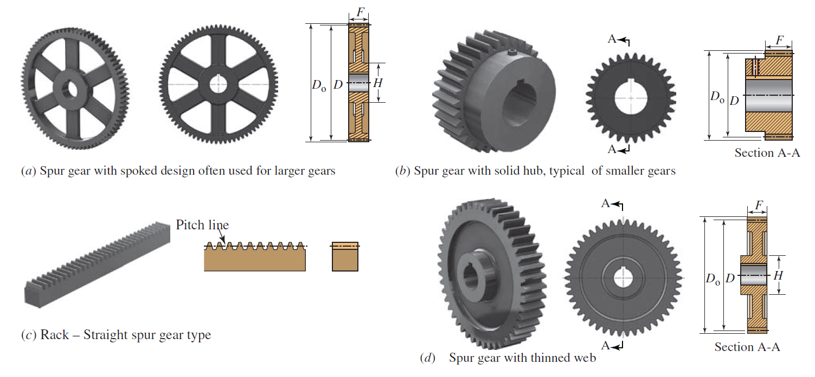
Spur Gears

Slide 24
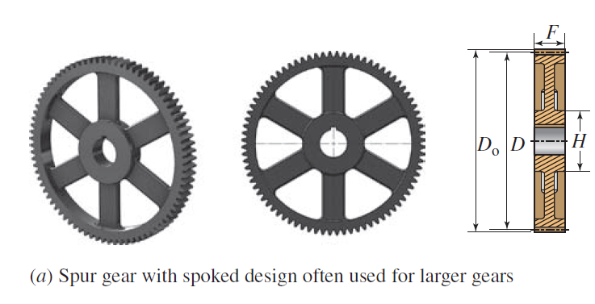
Spur Gears
When gears are large, the spoked design in Part (a) is often used to save weight. The gear teeth are machined into a relatively thin rim that is held by a set of spokes connecting to the hub.

Slide 25
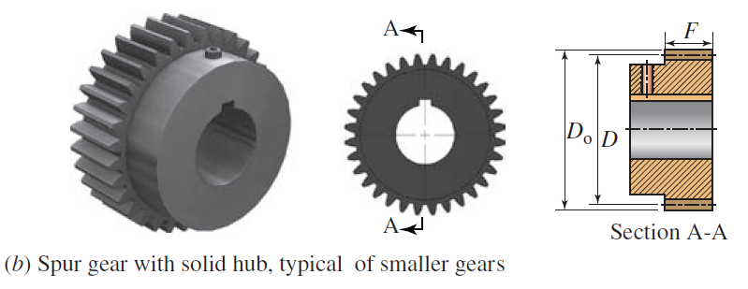
Spur Gears
The solid hub design is typical of smaller spur gears. Here the finished bore with a keyway is visible.
The set screw over the keyway allows the locking of the key in place after assembly.

Slide 26
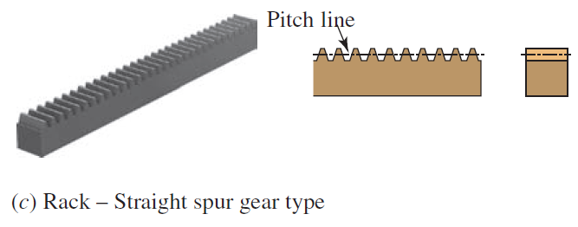
Spur Gears
When spur gear teeth are machined into a straight, flat bar, the assembly is called a rack.
The rack is essentially a spur gear with an infinite radius. In this form, the teeth become straight-sided, rather than the curved, involute form typical of smaller gears.

Slide 27
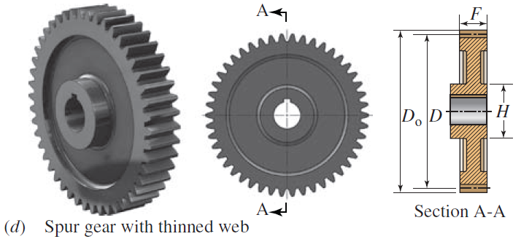
Spur Gears
Gears with diameters between the small solid form [Part (b)] and the larger spoked form [Part (a)] are often produced with a thinned web as shown in Part (d), again to save weight.

Slide 28
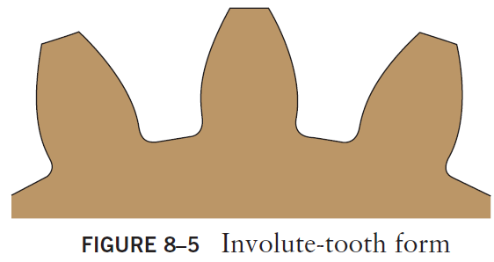
Spur Gear Geometry – Involute-tooth Form
The most widely used spur gear tooth form is the full depth involute form.
The involute is one of a class of geometric curves called conjugate curves.
When two such gear teeth are in mesh and rotating, there is a constant angular velocity ratio between them:

Slide 29
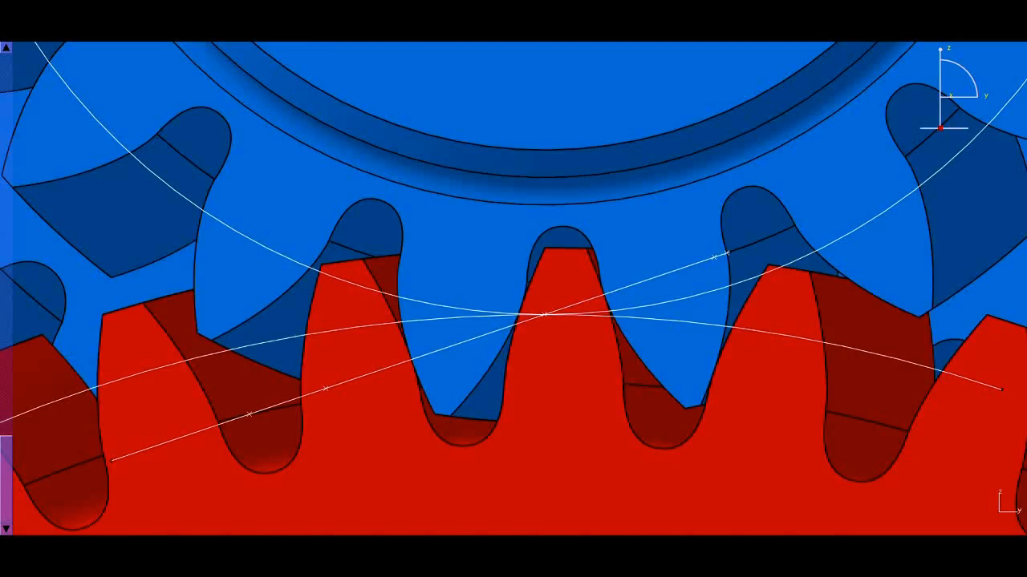
Gear Involute Profile Meshing

Slide 30
Gear Involute Profile Meshing
From the moment of initial contact to the moment of disengagement, the speed of the driving gear is in a constant proportion to the speed of the driven gear.
The resulting action of the two gears is very smooth.
If this were not the case, there would be some speeding up and slowing down during the engagement, with the resulting accelerations causing vibration, noise, and dangerous torsional oscillations in the system.

Slide 31
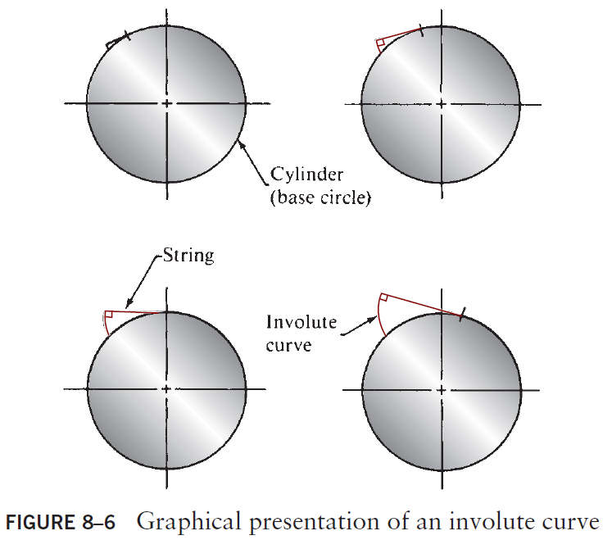
Involute Curve - Visualization

Slide 32
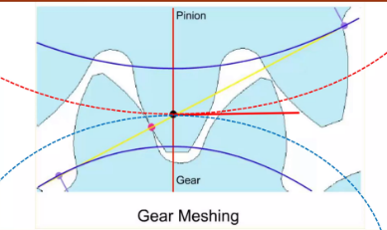
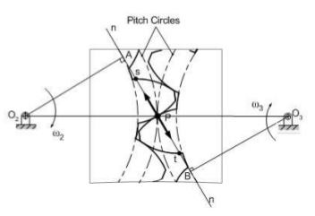
Law of Gearing
It is a fundamental principle of kinematics, the study of motion, that if the line drawn perpendicular to the surfaces of two rotating bodies at their point of contact always crosses the centerline between the two bodies at the same place, the angular velocity ratio of the two bodies will be constant. This is a statement of the law of gearing

Slide 33
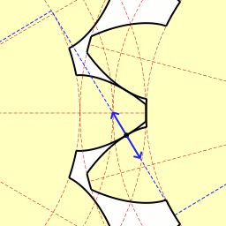
Law of Gearing

Slide 34
Law of Gearing
Two involute gears, the left driving the right: Blue arrows show the contact forces between them:
downward force applied by the left gear and
upward resistance by the right gear. The force line (or line of action) runs along the long leg of dashed blue line which is a tangent common to both base circles. The involutes here are traced out in converse fashion: points of contact move along the stationary force-vector "string" as if it was being unwound from the left rotating base circle, and wound onto the right rotating base circle.
In this situation, there is no force, and so no contact needed, along the opposite [lower left to upper right] common tangent (not shown).
In other words, if the teeth were slightly narrower while everything else remained the same there would be a gap above each tooth on the left gear, because downward force is being applied by it.

Slide 35
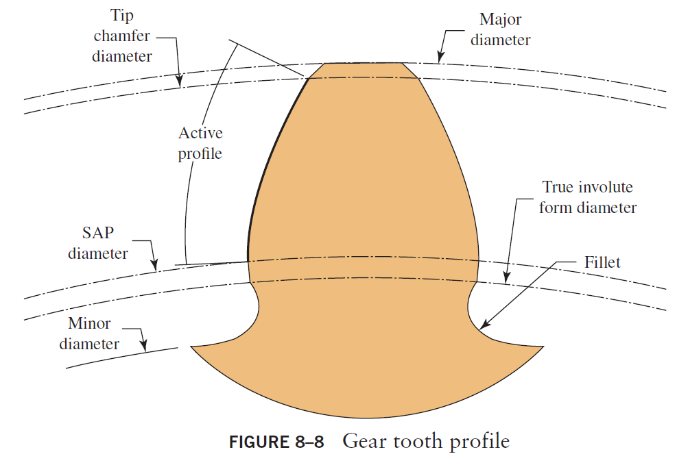
Gear Tooth Profile

Slide 36
Spur Gear Tooth-Features
American Gear Manufacturers Association (AGMA) defines standards for terms and symbols related to gears.
Because there is variation among the several applicable standards, the primary reference is AGMA 2001-D04 Fundamental Rating Factors and Calculation Methods for Involute Spur and Helical Gear Teeth.
Both the conventional U.S. system of units, called the Diametral Pitch System, and the SI metric system, called the Metric Module System, are discussed.

Slide 37
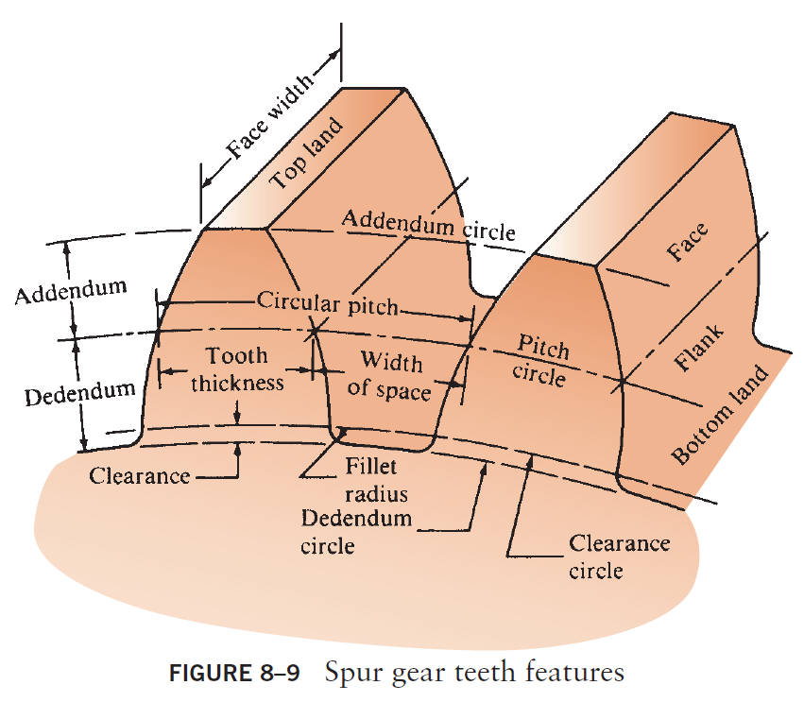
Spur Gear Tooth-Features

Slide 38
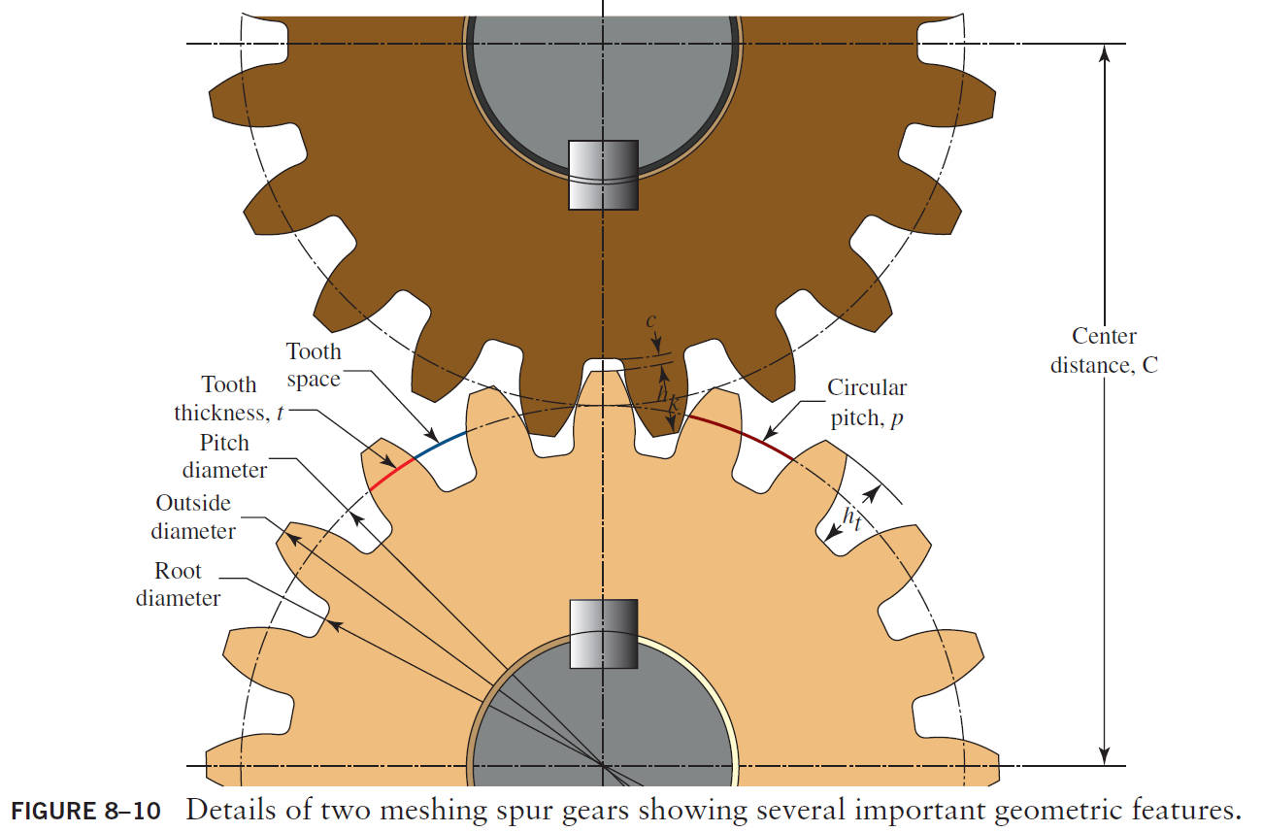

Slide 39
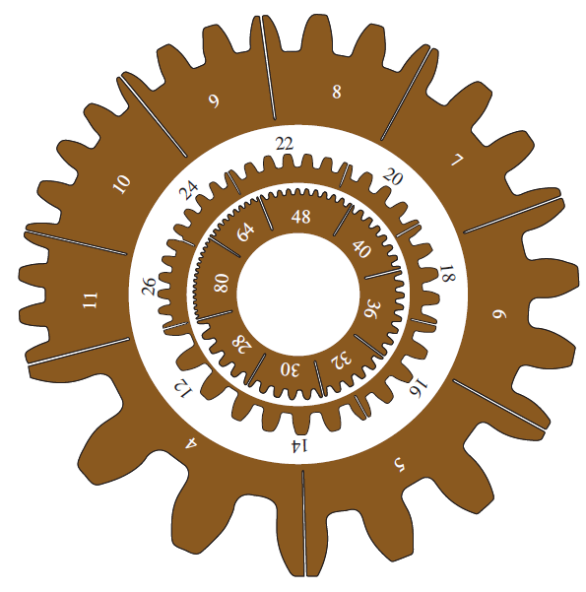
Spur Gears
Gear-tooth size as a function of diametral pitch—actual size

Slide 40
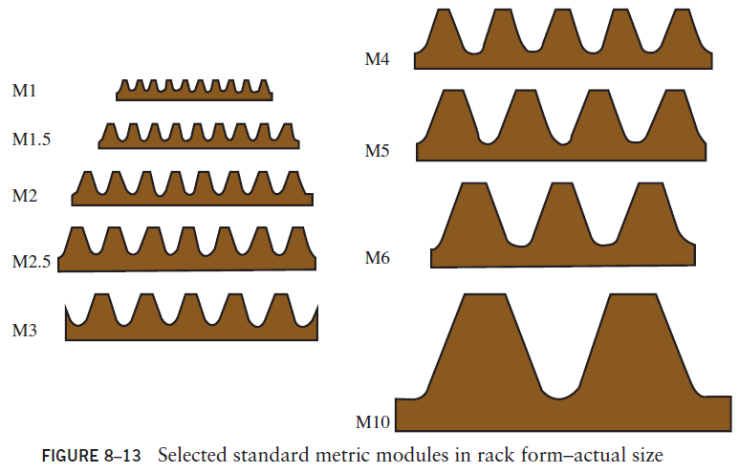
Spur Gears
When gears are large, the spoked design in Part (a) is often used to save weight. The gear teeth are machined into a relatively thin rim that is held by a set of spokes connecting to the hub.

Slide 41
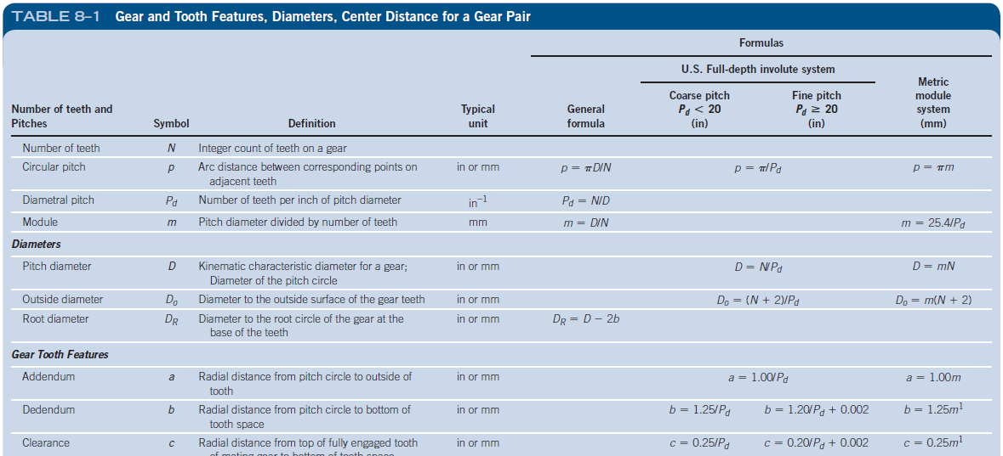
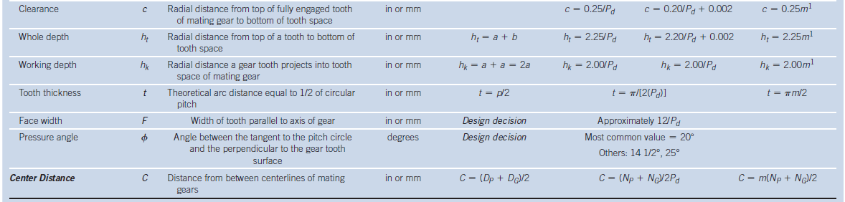
Spur Gears
When gears are large, the spoked design in Part (a) is often used to save weight. The gear teeth are machined into a relatively thin rim that is held by a set of spokes connecting to the hub.

Slide 42
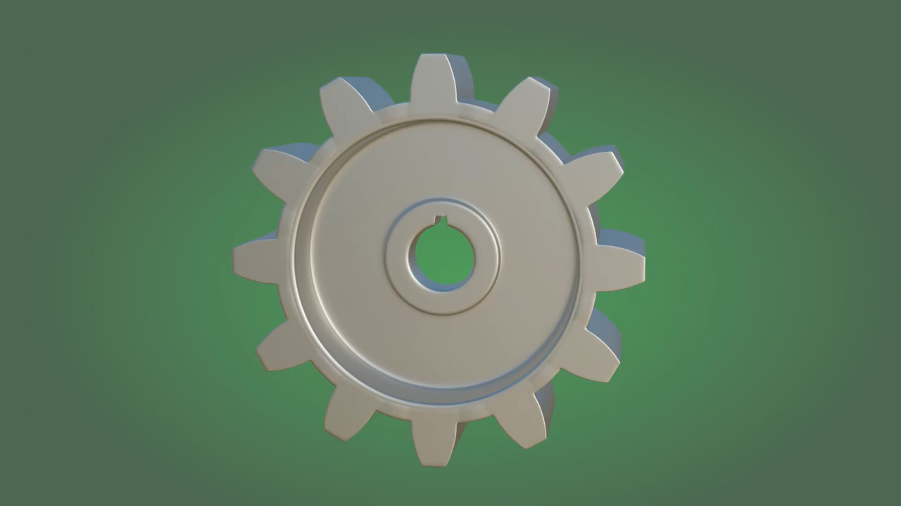
Gear Terminology

Slide 43
Accuracy of Representation
Gears and gear trains are precision mechanical devices with tolerances on critical dimensions typically in the range of a few ten thousandths of an inch (0.0001 in or about 0.0025 mm).
Therefore, it is expected that such dimensions be reported to at least the nearest ten thousandth of an inch (four decimal places) or the nearest 0.001 mm.

Slide 44
Gear Terminology
Pinion and Gear. For two gears in mesh, the smaller gear is called the pinion and the larger is called, simply, the gear.
Number of Teeth, N. It is essential that there are an integer number of teeth in any gear.
N_{P} for the pinion.
N_{G} for the gear.
Pitch. The pitch of a gear is the arc distance from a point on a tooth at the pitch circle to the corresponding point on the next adjacent tooth, measured along the pitch circle.

Slide 45
Gear Terminology
Pitch Circle and Pitch Diameter. When two gears are in mesh, they behave as if two smooth rollers are rolling on each other without slipping. The surface of each roller defines the pitch circle and its diameter is called the pitch diameter.

Slide 46
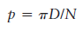
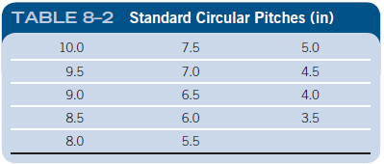
Gear Terminology
Circular Pitch, p. The pitch corresponding exactly to the basic definition of pitch given above is called the circular pitch, p.
➭ Circular Pitch

Slide 47
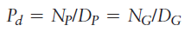
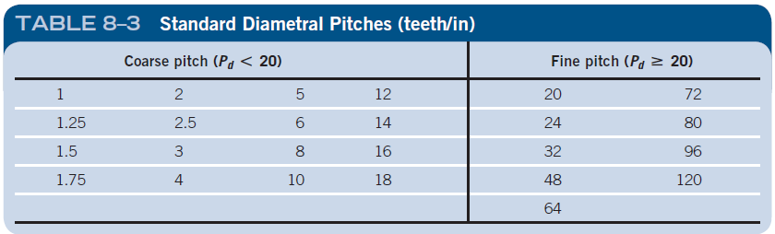
Gear Terminology
Diametral Pitch, Pd. The most common pitch system in use in the United States at this time is diametral pitch system.
➭ Diametral Pitch

Slide 48
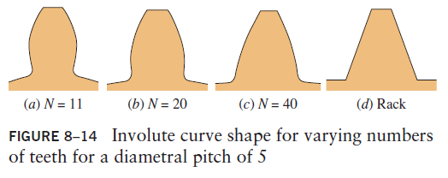
Gears
As the number of teeth increases for a given diametral pitch, the pitch diameter increases

Slide 49
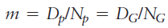
Gear Terminology
Metric Module, m. The metric module of the pinion and the gear must be same.
➭ Metric Module
Face Width, F. Face width is the width of the gear parallel to the axis of the gear.

Slide 50
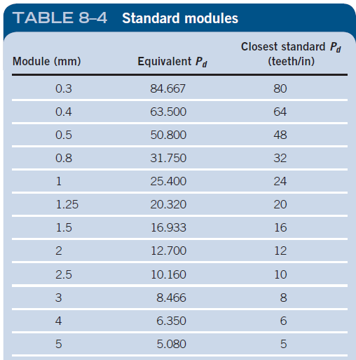
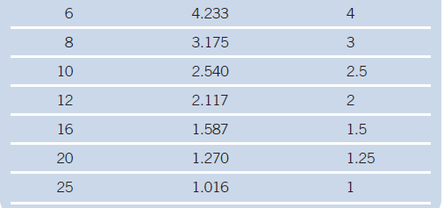
Gear Terminology
Center Distance, C. One of the most critical dimensions for a gear pair is the center distance, defined as the linear distance from the centerline of the pinion to the centerline of the gear

Slide 51
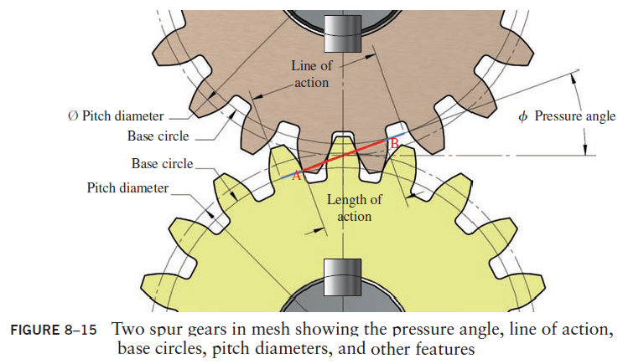
Pressure Angle
The pressure angle is the angle between the tangent to the pitch circles and the line drawn normal (perpendicular) to the surface of the gear tooth

Slide 52
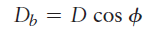
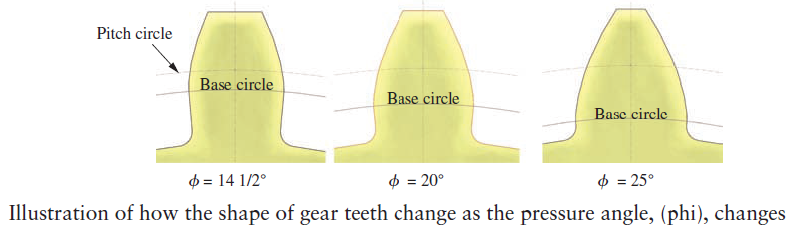
Gear Terminology
➭ Base Circle Diameter
As the pressure angle increases, the thickness at the bottom of the tooth increases. Therefore the larger the pressure angle, the stronger the tooth and the higher the load carrying capacity of the tooth.

Slide 53
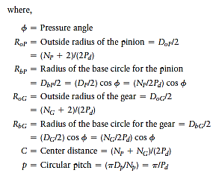
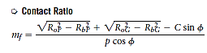
Contact Ratio
When two gears mesh, it is essential for smooth operation that a second tooth begin to make contact before a given tooth disengages.
The term contact ratio is used to indicate the average number of teeth in contact during the transmission of power. A recommended minimum contact ratio is 1.2 and typical spur gear combinations often have values of 1.5 or higher.

Slide 54
Example
For the pair of gears shown in Figure 8–1, compute all of the features of the gear teeth described in this section. The gears conform to the standard AGMA form and have a diametral pitch of 12 and a 20° pressure angle.

Slide 55
Spur Gears
When gears are large, the spoked design in Part (a) is often used to save weight. The gear teeth are machined into a relatively thin rim that is held by a set of spokes connecting to the hub.

Slide 56
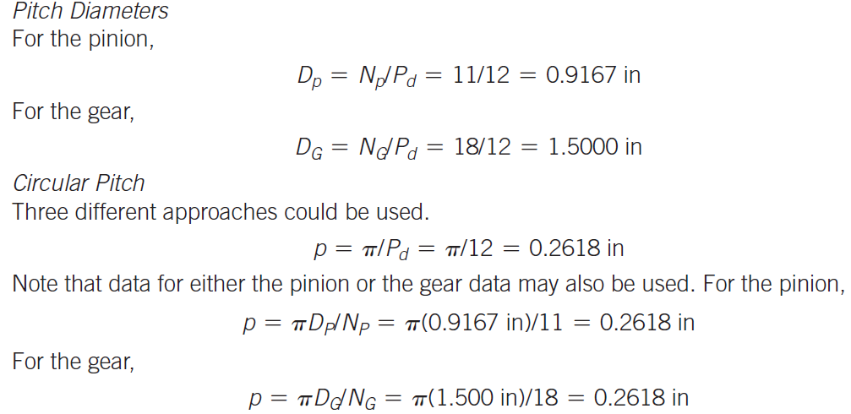

Slide 57
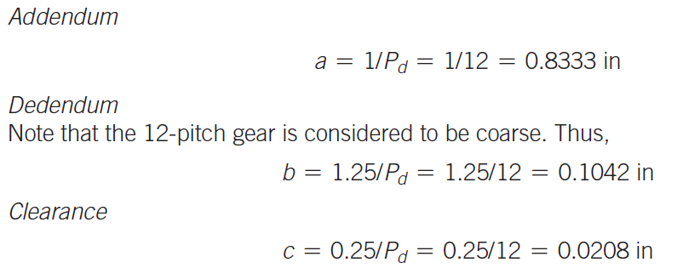
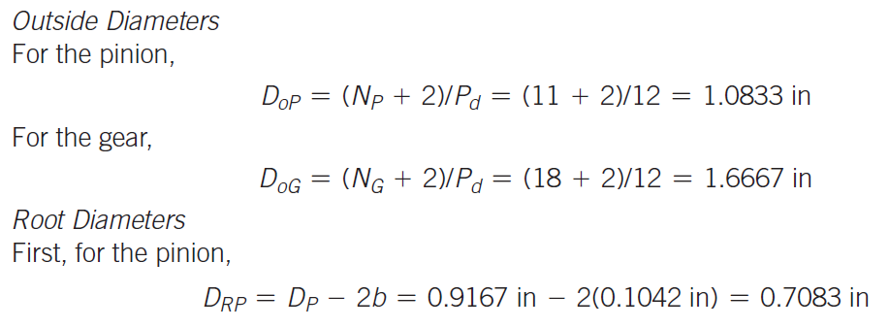

Slide 58
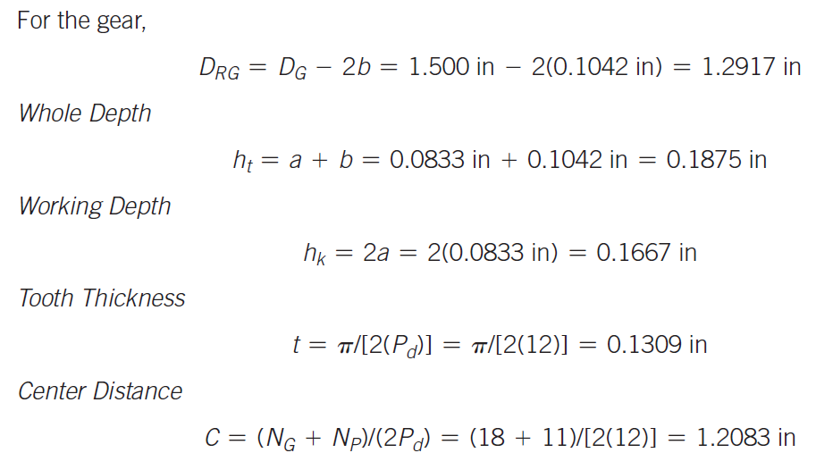
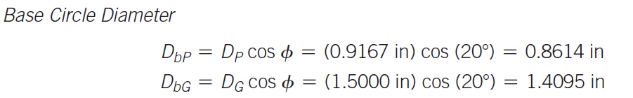

Slide 59
Interference Between Mating Spur Gear Teeth
For certain combinations of numbers of teeth in a gear pair, there is interference between the tip of the teeth on the pinion and the fillet or root of the teeth on the gear.
The probability that interference will occur is greatest when a small pinion drives a large gear, with the worst case being a small pinion driving a rack.
A rack is a gear with a straight pitch line; it can be thought of as a gear with an infinite pitch diameter

Slide 60

Interference Between Mating Spur Gear Teeth
It is the designer’s responsibility to ensure that interference does not occur in a given application.
The surest way to do this is to control the minimum number of teeth in the pinion to the limiting values

Slide 61
Interference Between Mating Spur Gear Teeth
Using the information in Table 8–7, we can draw the following conclusions:
If a designer wants to be sure that there will not be interference between any two gears when using the 14 12, full-depth, involute system, the pinion of the gear pair must have no fewer than 32 teeth.
For the 20°, full-depth, involute system, using no fewer than 18 teeth will ensure that no interference occurs.
For the 25°, full-depth, involute system, using no fewer than 12 teeth will ensure that no interference occurs.
If a designer desires to use fewer than 18 teeth in a pinion having 20°, full-depth teeth, there is an upper limit to the number of teeth that can be used on the mating gear without interference.

Slide 62
Interference Between Mating Spur Gear Teeth
For 17 teeth in the pinion, any number of teeth on the gear can be used up to 1309, a very high number.
Most gear drive systems use no more than about 200 teeth in any gear.
But a 17-tooth pinion would have interference with a rack which is effectively a gear with an infinite number of teeth or an infinite pitch diameter.

Slide 63


Slide 64

Overcoming Interference
Undercutting is the process of cutting away the material at the fillet or root of the gear teeth, thus relieving the interference.

Slide 65

An internal gear is one for which the teeth are machined on the inside of a ring instead of on the outside of a gear blank.

Slide 66

1. The gear rotates in the same direction as the pinion. This is different from the case when an external pinion drives an external gear.
2. The center distance is
➭ Center Distance-Internal Gear

Slide 67
References
Chapter 8, ‘Kinematics of Gears’
Machine Elements in Mechanical Design
By Robert L. Mott, Edward M. Vavrek, Jyhwen Wang, 6th edition

